Slide 1

SAP BTP ABAP on Cloud / RAP Training
DAY-3
Anubhav Oberoy
www.AnubhavTrainings.com
Follow excellence with sheer passion

Slide 2


DISCLAIMER
The training content and delivery of this presentation is confidential, and cannot be recorded, or copied and distributed to any third party, without the written consent of Anubhav Trainings

Slide 3

01
AMDP
ABAP Managed Data procedures
02
Challenges in ABAP Development
Common needs and challenges in ABAP Development with classic approach
03
RAP Introduction
Understanding RAP
04
RAP Use case
Scenario for development
Notes:
https://pixabay.com/photos/san-francisco-transamerica-pyramid-1633203/

Slide 4


























Slide 5
AMDP – ABAP managed Data procedure
Sometimes, the CDS performance is not suitable for our use case and we need more complex technique to process our data deep into database to get best performance using code-to-data paradigm
We want to use database specific features
CDS views have limitations
CDS views cannot be debugged
Overcome the disadvantages of CDS where we need to branch output of one Queries to another
We cannot write imperative logic using CDS – IF, ELSE, LOOP, WHITE, EXCEPTION etc.
CDS also does a strict type check while writing joins and associations
An AMDP is:
A static function in ABAP class marked with marker interface IF_AMDP_MARKER_HDB
The function can only have Import and Export parameters and all parameters must be passed by value
We cannot use complex data types (deep)
Any DB table which we plan to use with AMDP should be added to using clause
When we run the AMDP, A procedure gets created inside the DB
All the code will be written in SQL scripting programming language which will be pushed into the database
Since we directly execute AMDP in DB, there is no automatic client handling
www.anubhavtrainings.com

Slide 6
SQL Scripting
SQL Script is a programming language used inside databases, which is an advance version of plain SQL. It is the last option to improve performance of our applications and achieve code to data paradigm by code-push-down.
Why SQL Script
In the past we used to Fetch the data in ABAP, Loop over the data, Process the data and then write data back to database. We want to fully leverage the computational powers of SAP HANA, hence using SQL script we can achieve it. All our data intensive logic which we write using ABAP can now be pushed down to HANA DB using SQL Script.
https://help.sap.com/docs/SAP_HANA_PLATFORM?locale=en-US&task=use_task
SQL Script is not case-sensitive and every line ends with semi-colon (;)
We can use the code constructs like IF, ELSE, LOOP, FOR, WHILE, RAISE
When we create variables, they are assigned with null value
The = is comparison operator and := is the assignment operator. We can assign the value to variable using the var = val but when we use the variable in the code, we use value of (:) operator to use a variable.
When we assign the a query to a variable, the variable will allocate memory automatically
www.anubhavtrainings.com

Slide 7
CDS Table function
Bridge the gap between CDS and AMDP, A CDS table function
Defines the skeleton of the data which we want from DB
When it executes, it actually calls SQL Script code
It creates a FUNCTION database unlike AMDP creates a PROCEDURE in database
The CDS table function, can later be used to build view on view or can be used in OTHER CDS views also as JOIN/Agg
Plain CDS functions:
https://help.sap.com/doc/abapdocu_752_index_htm/7.52/en-US/abencds_f1_builtin_functions.htm
www.anubhavtrainings.com

Slide 8




Challenges in ABAP development
UI
Common needs
Create application logic
Insert, update, delete, validate, select data
Perform validations
Check customizing
Handle locks
Create A/c documents
Manage Documents
Application Code
I, U, D, S, V
Search Documents
Validate before save
Alex, ABAP Developer,
SAP FICO
UI
Challenges
Thinks differently
Adapt application code
High maintenance
No standardization
Different coding practices
Lack of standard
Create Sales Orders
Manage Sales Orders
Application Code
I, U, D, S, V
Search/Filter Sales Order
Compute Sales total
Stella, ABAP Developer,
SAP SD
www.anubhavtrainings.com

Slide 9
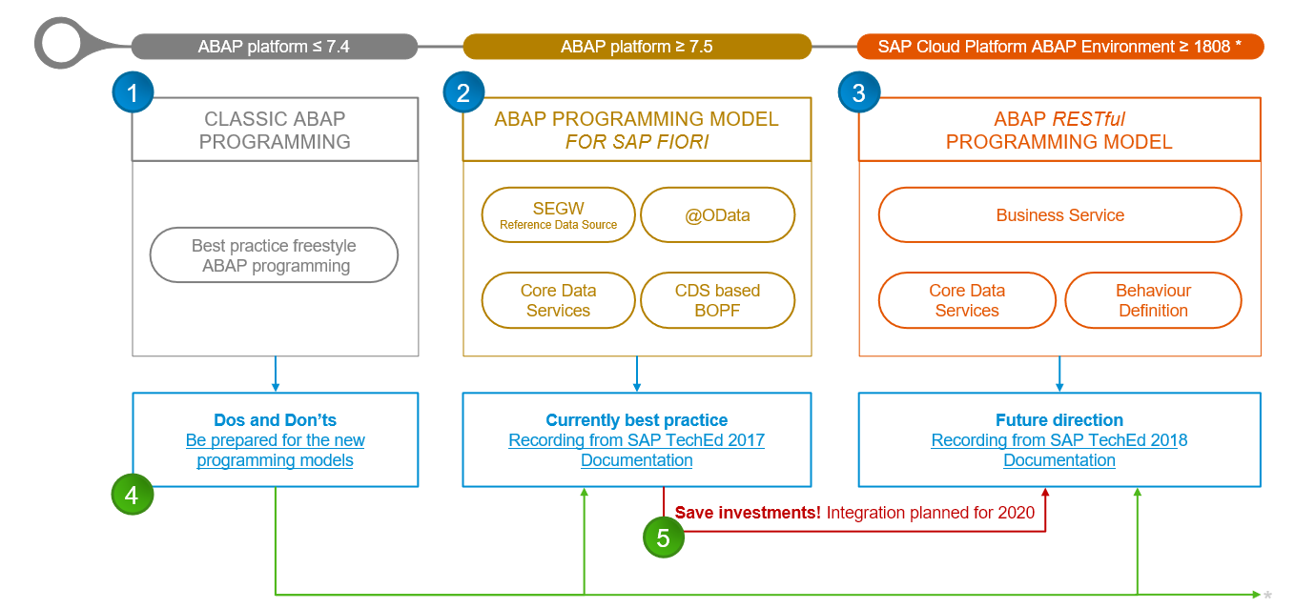
Evolution of ABAP Programming Model
www.anubhavtrainings.com

Slide 10
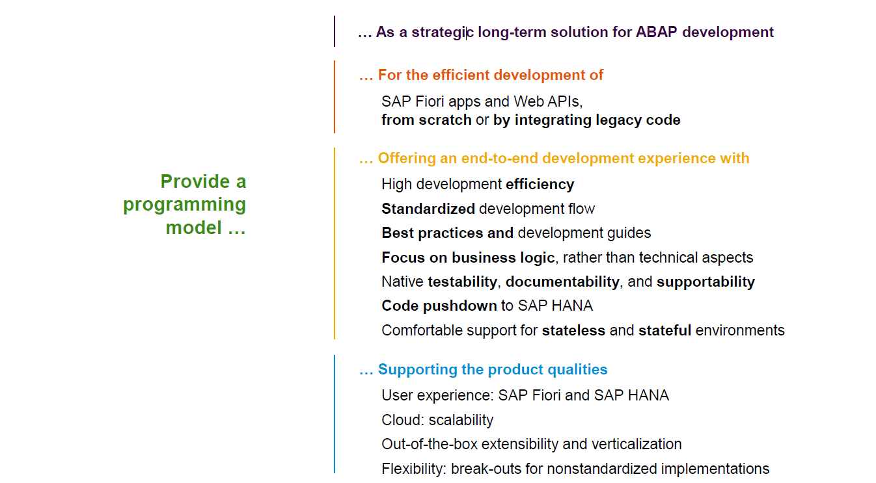
Restful ABAP Programming
www.anubhavtrainings.com

Slide 11
Restful ABAP Programming
The ABAP RAP (Restful Application Programming) Model defines the architecture for efficient application development for HANA optimized ABAP applications. It supports development of
Greenfield applications – A completely new application from scratch
Brownfield applications – A new/extension of application using OLD code
It is based on proven technologies and frameworks such as CDS entities to define semantically rich data model and service model infrastructure for creating and binding OData services for different use cases e.g. Fiori App, WebAPI, InA
www.anubhavtrainings.com

Slide 12
Components in RAP app – Technical Level
CDS entities – To develop our RAP BO (Business Object)
Business Object here is a TREE data structure which is composed of multiple nodes (parent, child), The tree starts from a root node.
Once the business object is ready, we define the behavior of the business object like can this object be created, updated, deleted. Business object is a static structure (like a class) and the records of actual data is the instance of BO (object of a class).
Finally we can create service definition and service binding
UI layer to consume the service to build application.
www.anubhavtrainings.com

Slide 13
Development Approach
Application UI (Fiori Apps)
Transactional | Analytical | Factsheet
Analytical Tools
Excel | SAC | Other..
Third Party
Your own ABAP code
Service layer (expose data over HTTP/HTTPS protocol) – OData Services (V2, V4)
SEGW, SADL, @OData, Serv. Definition and Binding
API Layer
Business logic, Data validations, Lock Unlock, Sync. Points, Branches, Manipulation logic, data flow logic, processing logic - RICEF
Customizing layer (SPRO, SM30)
Database Layer – (function modules and classes to interact with database)
LUW, Update FM, BAPIs – SELECT INSERT MODIFY UPDATE DELETE, EQ, DQ
SE11 – Data Dictionary – Tables, Views, Data Elements, Domains, LO, MC…
www.anubhavtrainings.com

Slide 14


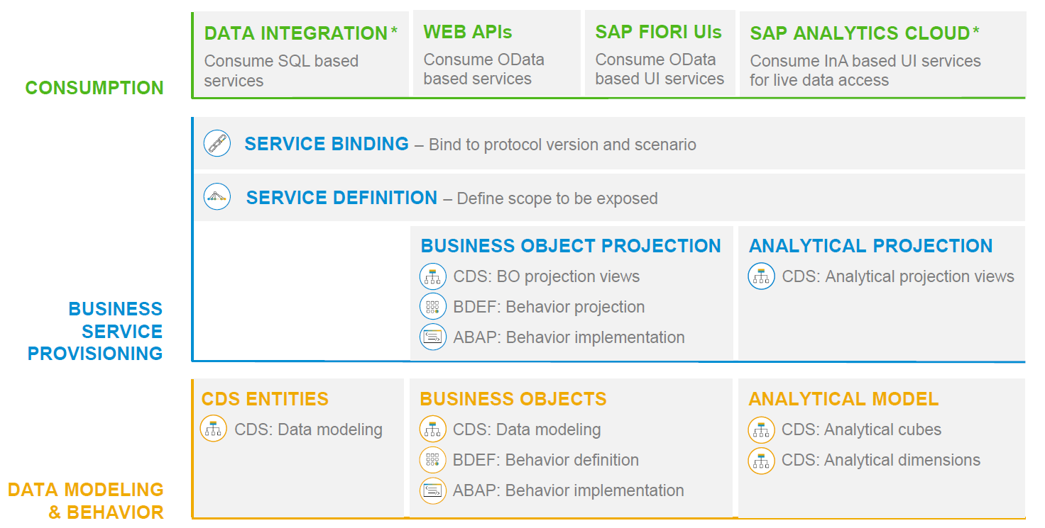
RAP – The Big picture
www.anubhavtrainings.com

Slide 15
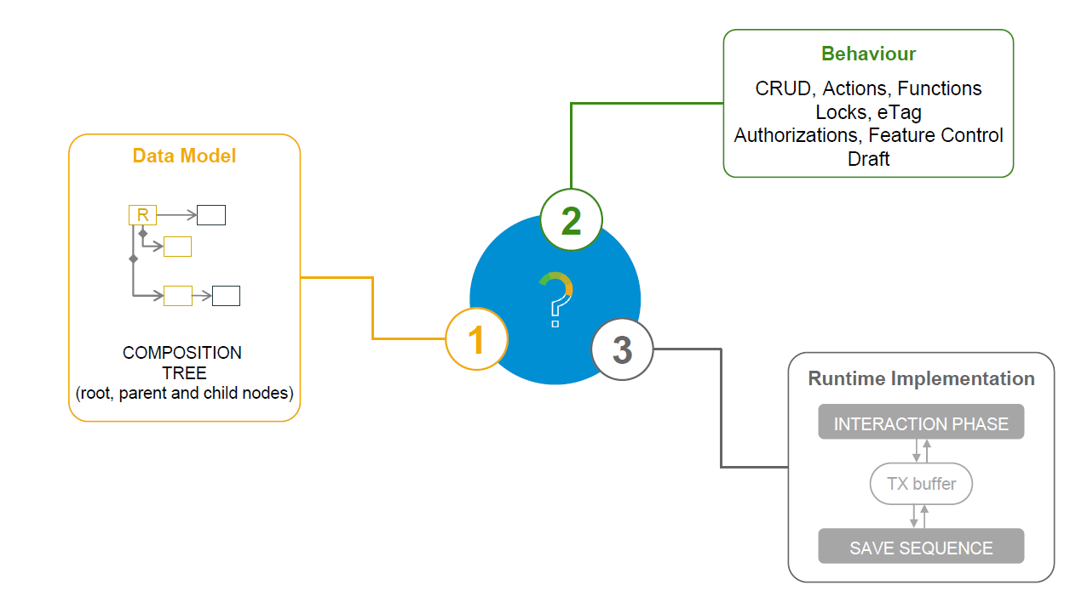
What is a Business Object
www.anubhavtrainings.com

Slide 16
Types of Implementation (Scenario)
Brownfield Implementation
Is used when we want to create a transactional application which can insert, update, delete data from the system by writing your own logic
You already have Business logic with you and you want to use that business logic to perform transactional capability
You are own your own to manage your implementation.
02. Managed Scenario
Greenfield Implementation
Is used when we want to create a transactional application which can insert, update, delete data from the system by using the framework provided implementation
You do not have Business logic with you and you want system to create business logic for you automatically.
01. Un-Managed Scenario
www.anubhavtrainings.com

Slide 17
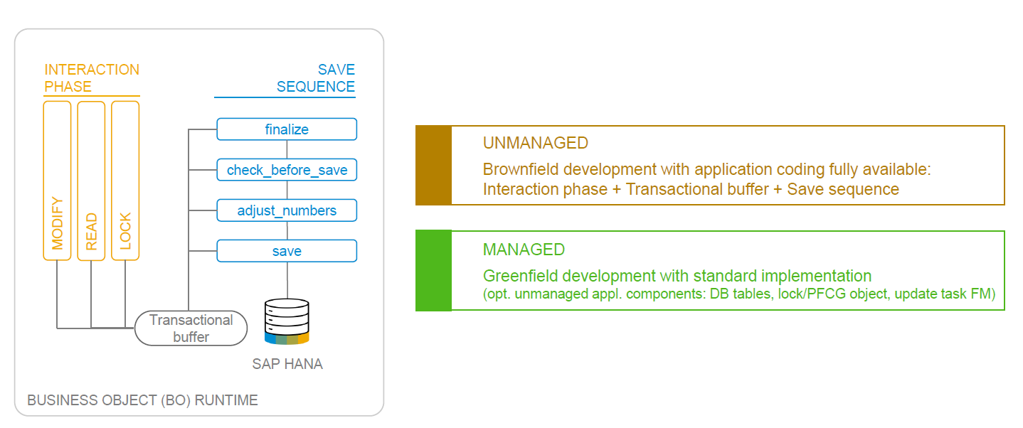
BO Runtime Implementation Types
www.anubhavtrainings.com

Slide 18

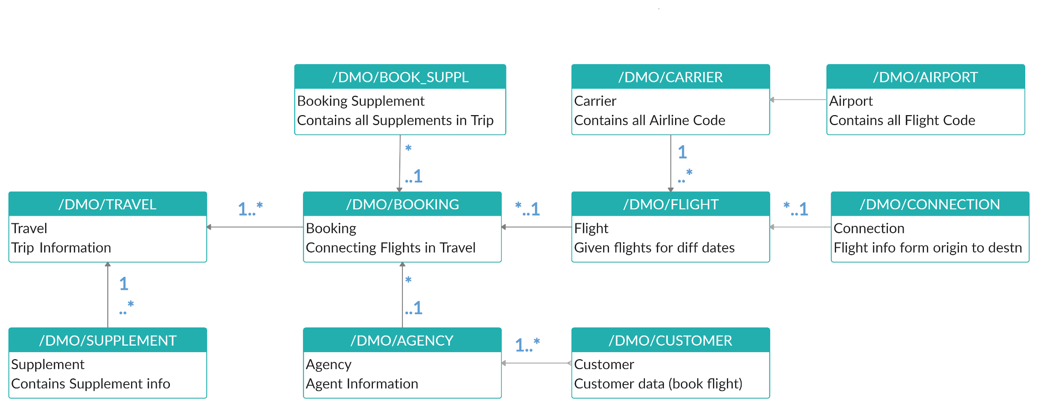
Explanation of Flight Data Model
_M
_M
_M
If Data is not found in these Table’s please execute Data Generator Class “/dmo/cl_flight_data_generator”
www.anubhavtrainings.com

Slide 19
Managed RAP implementation
The managed RAP implementation addresses use cases where all the essential parts of the applications are to be developed from scratch. However, these new applications can highly benefit from out-of-box support for transactional processing. Standard operations like create, update, delete must only be specified in the behavior definition to obtain a ready-to-run business object. The provisioning of transaction buffer is also done automatically for us by the framework. The interaction phase and save sequence are also implemented generically. The application developer can focus on business part of app like adding custom validation, actions, determinations. The RAP transaction engine manages the life cycle of our Business object and covers all the aspects of our app development.
The managed implementation type is aimed for building new applications from scratch without having any prior coding exist. The standard functionality that given in managed business objects is easily retrieved. The business logic implemented using predefined implementation methods that are integrated during the runtime in the interaction phase and save sequence.
www.anubhavtrainings.com

Slide 20



Business use case
We will implementing 2 different applications on travel data model. These applications will target different user groups. We will manage the travel requests and booking through our applications which are booked by agency for customer.
Processor – a processor is an employee of our company who will request a new travel plan through the application. He/she will be allowed to create, update, delete, copy travel requests including bookings and supplements. They have full control to manage their travel.
Approver – an approver is a manager who will only be able to view the travel requests created by employees, and can only change the booking fees and approval status of the request (approve/reject).
MakeMyTrip.com- processor app
Processor needs to create, update, delete a travel request through agency including all bookings and supplements
Approval App
The manager would review the travel requests created by processor, can only change the booking fees and approve or reject the travel request
www.anubhavtrainings.com

Slide 21
Understanding projection
If we ever get requirement in our company to develop a use case where we want to reuse the data model (e.g. sales, purchase, accounting, finance) but develop many applications. We will go with RAP and projections. A projection takes part of the base functionality according the needs to user. This will reduce effort, increase reusability in our app.
www.anubhavtrainings.com

Slide 22
Business Object Definition
From structural point of view, a business object consists of a tree of entities (cds) that are linked in compositions. Every entity in this composition tree is an element that is modeled with CDS view entities. For our demo travel scenario we will implement 3 level composition tree.
/dmo/travel_m
(root entity)
1..N
Business Object
/dmo/booking_m
(child entity)
1..N
/dmo/bookingsuppl_m
(child entity)
www.anubhavtrainings.com

Slide 23
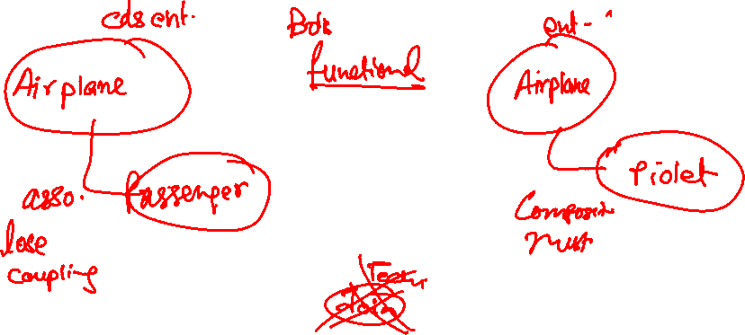
Association v/s Composition
Both are the relation between cds entities
Association – lose coupling between entities, both objects can function independently (created, updated and deleted), it is always a good to have relation.
Composition – tight coupling between entities, both objects must function together, there is a MUST have relationships because they cannot work independently
www.anubhavtrainings.com

Slide 24
www.anubhavtrainings.com
Thank You
End of Day 3
www.anubhavtrainings.com

Slide 25


We’re committed to empower you to be
#FutureReady
through powerful training solutions.
We build the workforce of the future.
250+
Corporate Clients
30,000+
Learners Trained
25000+
Learners Placed
FREE WEBINARS
Sign up for free webinars with industry experts every fortnight!
Enroll Now!
Contact us today!
https://anubhavtrainings.com

